Slide 1
Introduction to Container Orchestration
TechSpark
The IAEA Tech Talks
Casimir Compaore
Rina Ahmed
SGIS – Safeguards – IAEA

Slide 2
Agenda
Containers
Kubernetes
GitOps
Service Mesh
Serverless
What Next?

Slide 3
Keywords on us ☺
Casimir
Rina
SGIS TechLead
Introduced and managed Kubernetes from scratch
Soccer
SGIS TechLead
Tech Evangelist and Microsoft-crazy
Literature

Slide 4
Containers
App decoupled from OS
App packaged with its dependencies
Immutable: nothing changes in Production
Container
Container
Container
App
App
App
Bin, Lib
Bin, Lib
Bin, Lib
Container Engine
Host OS
Server

Slide 5
Containers
Build images
Push into image registry
Run container
Security, vulnerability scanning
Notes:
Another box before run container. Security and vulnerability scanning (CI/CD)

Slide 6
Docker
Docker supports Open Container Interface (OCI) Standard
Kubernetes runs a different container engine but supports OCI
Demo

Slide 7
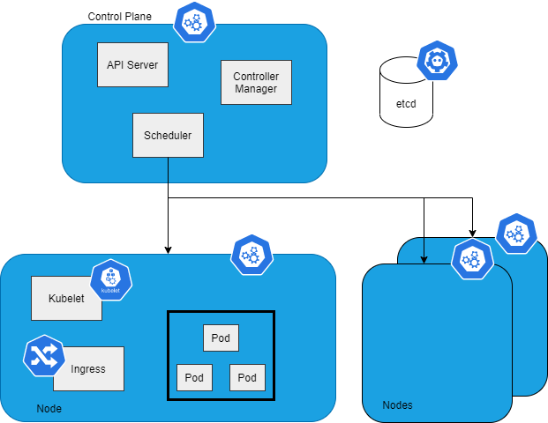
Kubernetes

Slide 8
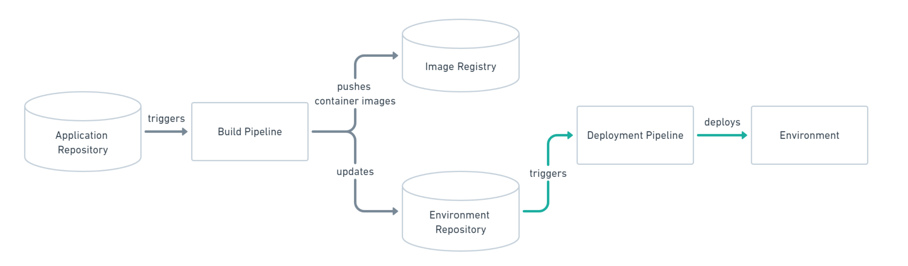
GitOps
Describe Infrastructure as Code in a Git repository
Trigger CI/CD for Desired State
Version control for infrastucture changes
Code Reviews, Pull Request, Comments
Revert to previous Infrastructure version

